Slide 1
Chapter 1
New Venture Finance

Slide 2
Learning Objectives
Describe the evolution of thinking about entrepreneurship
Recognize that studying entrepreneurial finance leads to better investment and financing decisions
Understand why maximizing value for the entrepreneur is central to the study of entrepreneurial finance
Describe the process of new venture formation from inception to harvesting
Distinguish the various stages of new venture development
Understand how the FIRE framework of Entrepreneurial Financing
Understand the value of tying new venture financing to milestones that mark a venture’s progress
Understand how the business plan is related to strategic planning and implementation

Slide 3
1.创业企业发展阶段与融资
Notes:
监管者视角：preparing for the assessment of the viability and sustainability of their business models by regulators and investors in light of the on-going challenging environment;
and
管理层视角：
analysing their business models to ensure they are maximising shareholder value.

Slide 4
Entrepreneurship is Multidimensional
The entrepreneur must:
perceive an opportunity to create value by redeploying society’s resources
devise a strategy for marshaling control of necessary resources
implement a plan of action to bring about the change
harvest the rewards that accrue from the innovation
Notes:
These are all elements of the entrepreneurial process

Slide 5
Types of Entrepreneurship
Replicative versus innovative
Opportunity-based versus necessity-based
Corporate Venturing
Social Venturing
Notes:
What Is a Serial Entrepreneur?

Slide 6
Replicative vs. Innovative Entrepreneur
Replicative entrepreneurs function as efficient coordinators of resources
start and maintain businesses that mimic predecessors
provide more of existing goods and services
Innovative entrepreneurship reshapes industries and has the potential to add huge value to economies
e.g. Google, Intel, Facebook, and e-Bay

Slide 7
Necessity-based vs. Opportunity-based Entrepreneurship
Necessity-based entrepreneurs start businesses due to a lack of alternatives
small, low-capital ventures
almost always replicative
common in emerging economies
Opportunity-based entrepreneurs are motivated by the idea
accounts for virtually all innovative entrepreneurship
most frequently found in developed economies

Slide 8
Two types of Entrepreneurship
Small and Medium Enterprise (SME) Entrepreneurship , This is the type of business that is likely started by one person to serve a local market and grows to be a small or medium-size business that serves this local market.
Innovation-Driven Enterprise (IDE) , IDE is the more risky and more ambitious of the two. IDE entrepreneurs are aspiring to serve markets that go well beyond the local market. They are looking to sell their offering at a global or at least at a regional level.

Slide 9
Corporate Venturing
Corporate venturing is common for projects requiring
large and complex research teams
generic testing equipment
lengthy development times
Incentives to encourage entrepreneurship are difficult to implement in large organizations
motivating people to work on the right projects
rewarding success
perceived inequities

Slide 10
Social Venturing
Primary objective of the venture’s product or service is to address a social issue
Financial returns are traded off against social objectives
Includes efforts by non-profit entities to create for-profit subsidiaries, e.g. museum shops
Recent trend in “green-tech” or “clean-tech”

Slide 11
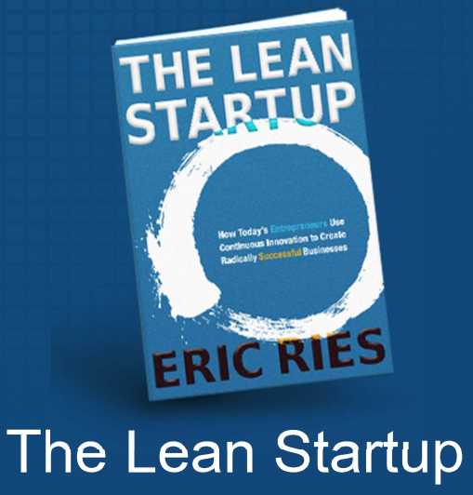
初创企业
A startup is a human institution designed to deliver a new product or service under conditions of extreme uncertainty.
Nothing to do with size of company, sector of the economy, or industry.
STARTUP=EXPERIMENT
Notes:
创业者：Entrepreneur
Joseph Schumpter(1912)把创业者定义为积极寻找机会创新的人，创业者是经济进步的驱动者，通过谨慎冒险行为，整合社会资源，以追求利润为导向，不断寻求打破现状，创造社会价值。（颠覆性性创新,Disruptive Innovation）
Frank Knight(1921)把创业者定义为不确定性的管理者，”由于不确定性的存在......主要的问题或者工作室决定做什么以及如何去做。”
Peter Druck（1985，P20）: 创造新东西、想法独到、改变或者创造价值
Austrian economist Joseph
Schumpeter, who described entrepreneurship as a recombination of existing resources to create something new.6

Slide 12
Entrepreneurship and the Entrepreneur
What is an Entrepreneur?
R. Cantillon（early 1700s） – bearer of risk in provision of capital（哥伦布发现新大陆背后的金主）
J. B. Say（early 1800s） – shifter of resources to higher productivity
J. Schumpeter（1912） – innovation as disturbing status quo
（颠覆式创新）
F.Knight (1921)– directs resources in the presence of uncertainty
P. Drucker(1985) – creating something new, transmuting value
Modern view
pursuit of opportunities to combine and redeploy resources without regard to current ownership or control of the resources（共享经济）
Notes:
创业者：Entrepreneur
Joseph Schumpter(1912)把创业者定义为积极寻找机会创新的人，创业者是经济进步的驱动者，通过谨慎冒险行为，整合社会资源，以追求利润为导向，不断寻求打破现状，创造社会价值。（颠覆性性创新,Disruptive Innovation）
Frank Knight(1921)把创业者定义为不确定性的管理者，”由于不确定性的存在......主要的问题或者工作室决定做什么以及如何去做。”
Peter Druck(1985，P20): 创造新东西、想法独到、改变或者创造价值
Joseph Schumpter(1912)把创业者定义为积极寻找机会创新的人，创业者是经济进步的驱动者，通过谨慎冒险行为，整合社会资源，以追求利润为导向，不断寻求打破现状，创造社会价值。（颠覆性性创新,Disruptive Innovation）
Frank Knight(1921)把创业者定义为不确定性的管理者，”由于不确定性的存在......主要的问题或者工作室决定做什么以及如何去做。”
Peter Druck（1985，P20）: 创造新东西、想法独到、改变或者创造价值
Austrian economist Joseph Schumpeter, who described entrepreneurship as a recombination of existing resources to create something new.6

Slide 13
创业的类型（Muller,1972)
An idea for developing a new invention；
A new marketing technique ;
A more efficient organizational structure for the firm;
Example for each type?
Notes:
3 We thus combine the theories of Knight [22] and Schumpeter [43] by emphasizing
the uncertainties surrounding innovations as the chief determinants of profit and en

Slide 14
Entrepreneur and Entrepreneurial Process
Entrepreneurial Process
机会识别，重新配置资源创造价值；
制定战略，获得必须的资源（人、财、物）；
实施战略，进行创新；
从创新中获得回报；
Three Fundamental Principles of the Entrepreneurial Process
1 Resource-gathering，
2 Uncertainty（ ambiguity）, and
3 Experimentation
Implications of the 3 Principles
Notes:
创业者（Enrepreneur):来源于法语，承担做某事的人，风险的承担者。
A common misconception is that entrepreneurs are inventors who discover the solution in a single Aha! moment. In reality, solutions are often found through
an iterative process of experimenting across many different possibilities and taking in feedback from multiple sources. The design thinking movement has
tried to provide some methodologies to the process of discovering solution.
Design thinking is a broad concept that has affected a wide array of creative activities: from architecture to social work to innovation to business. There is
no single definition of what design thinking is, but the founder of the Stanford Design School suggests the following four fundamental principles.
First, all design is human-centric; second, designers retain ambiguity to remain open to different forms of experimentation; third, all design is redesign, since technologies and social circumstances are in constant flux; and fourth, making designs tangible helps communication with others.
The first principle is based on the work of the Austrian economist Joseph
Schumpeter, who described entrepreneurship as a recombination of existing
resources to create something new.6 The entrepreneurial process therefore
consists of gathering resources from a variety of owners and combining them
in a novel and valuable way. Financing is one of the most important resources
that entrepreneurs need to gather. It plays a special role because money allows
entrepreneurs to acquire other resources. Fundraising is therefore a crucial step
in the entrepreneurial process.
The second principle reflects the fact that the entrepreneurial process is inherently uncertain. The American economist Frank Knight argued that there is
an important difference between risk and uncertainty.7 Risk refers to situations
where the outcome of a process is not known in advance but there is reliable
information about the underlying probability distribution of outcomes. For
example, when we throw a dice, we do not know which side will show, but we
know it can be only one of six. Uncertainty, by contrast, means that the range of
outcomes and their probabilities are themselves unknown. For example, no one
knows the probability of finding extraterrestrial life, let alone what it will look
like. The entrepreneurial process fits the latter category. Entrepreneurs lack reli_x0002_able information about the range or likelihood of outcomes, let alone about the
relationship between their actions and those potential outcomes. This ambiguity
is not coincidental. We call an opportunity “entrepreneurial” when there is con_x0002_siderable uncertainty. By the time the outcomes are well understood, the busi_x0002_ness opportunities are no longer entrepreneurial but managerial.8
His work is mostly con_x0002_cerned with how organizations make decisions and how they learn over time.
March introduced the distinction between “exploitation” and “exploration” as two opposite organizational models.
Experimentation is intrinsic to en_x0002_trepreneurship because the process of exploring new opportunities inevitably
leads to surprises and dead-ends. Entrepreneurs have no choice but to adapt their plans over time. In modern business lingo, this is referred to as “pivoting" Established businesses, by contrast, rely on consistent execution of established
routines and find it more difficult to engage in experimentation
The first principle implies that the
money offered by investors will play a vital role in the development of the ven_x0002_ture. The second principle says that investors will have to live with uncertainty at every step of the process. The third principle suggests that investors, too, need to be flexible when working with entrepreneurs. Together these principles imply that the process of financing start-ups proceeds in stages, where at every stage one faces uncertainty, experimentation, and learning.

Slide 15
What is Entrepreneurial Finance?
Financial aspects of entrepreneurship and investing in entrepreneurial ventures（Entrepreneurial companies are young, typically being less than 10 years old.The younger among those companies are called “start-ups” and are typically less than five years old.）
Designed to improve investment and financing decisions in entrepreneurial settings
All stages covered—start-up to harvest
Structuring deals and incentives
Evaluating strategic choices
Financial modeling
Question：
What is the biggest difference between entrepreneurial ventures(初创企业） and Established Firms(成熟企业）？ small businesses or small and medium-sized enterprises (，中小企业SMEs).
start-ups, entrepreneurial company, and ventures
Notes:
entrepreneurial finance as the provision of funding to young, innovative, growth-oriented companies.
A study by Koellinger
and Thurik documents the importance of entrepreneurial companies for gener_x0002_ating business cycles.2 Of central importance is that entrepreneurial companies
are growth-oriented. This sets them apart from small businesses or small and
medium-sized enterprises (SMEs).3 Even though entrepreneurial companies
typically fall within the statistical definitions of small businesses (e.g., businesses
with fewer than 250 employees), in practice they have little in common with
their statistical peers. Most small businesses are created to remain small: think
of corner shops or business services. Hurst and Pugsley’s study of U.S. small
businesses finds that less than a quarter wanted to grow big.4
Instead, entrepreneurial companies have the ambition to grow much larger by pursuing some innovation.
Put simply, small businesses represent the status quo, whereas entrepreneurial businesses challenge it.

Slide 16
What Is Entrepreneurial Finance?
Entrepreneurial finance is at the epicenter of a clash of two worlds: the world of entrepreneurship and the world of finance.
The world of finance is a disciplined and orderly world, based on taking calculated risks and looking for proven track records.
Entrepreneurship is a messy and disruptive affair, based on treading into the unknown off the beaten track.
Finance is based on numbers and logical thinking and is associated with left-brain thinking. Entrepreneurship is based on intuition and experimentation and is associated with right-brain thinking。
Notes:
These are all elements of the entrepreneurial process
At the core of entrepreneurial finance there is an exchange between an en_x0002_trepreneur and an investor, where the entrepreneur receives money and in re_x0002_turn gives the investor a claim on the company’s future returns.This claim is
embedded in a funding contract between entrepreneurs and investors, which requires a well-functioning legal system, as well as trust among the parties. Some investors take equity, others provide loans, and still others use a variety of alternative arrangements. Entrepreneurs need to understand the consequences of these contracts. This complex world can be confusing, especially to inexperi_x0002_enced entrepreneurs.
we need to consider the whole entrepreneurial process through which entrepreneurs turn ideas into
businesses. This is a long and risky process: success takes many years, and failure is always lurking around the corner.

Slide 17
The Finance Paradigm
More of a good is preferred to less.
Present wealth is preferred to future wealth.
Safe assets are preferred to risky assets.
We use these guidelines to make:
investment decisions, i.e., what assets to acquire
financing decisions, i.e., the types and mix of funding sources

Slide 18
The Importance of Real Options
A real option is a right, but not an obligation, to undertake a decision about a non-financial (i.e., “real”) asset.
Examples: abandon a poorly performing venture or expand a venture doing well
Values of real options depend importantly on the degree of uncertainty surrounding the investment.

Slide 19
Objective: Maximizing Value for the Entrepreneur
Corporate managers often focus on maximizing shareholder value
We focus decision making on maximizing the value for the entrepreneur
May be different from maximizing the value of the venture
All investors may benefit from knowing the entrepreneur’s objective

Slide 20
The Importance of Real Options
A real option is a right, but not an obligation, to undertake a decision about a non-financial (i.e., “real”) asset.
Examples: abandon a poorly performing venture or expand a venture doing well
Values of real options depend importantly on the degree of uncertainty surrounding the investment.

Slide 21
Objective: Maximizing Value for the Entrepreneur
Corporate managers often focus on maximizing shareholder value
We focus decision making on maximizing the value for the entrepreneur
May be different from maximizing the value of the venture
All investors may benefit from knowing the entrepreneur’s objective

Slide 22
Stages of New Venture Development
Figure 1.4
Notes:
Figure 1-4 – Stages of New Venture Development
The figure shows the standard progression of development of a new venture from opportunity identification though stages culminating in exit. At each stage, the figure indicates the kinds of actions that normally are associated with the stage, as well as some of the real options the entrepreneur is likely to face.

Slide 23
Measuring Progress with Milestones
Enable the parties to postpone financial commitments until needed
Function as a working hypotheses
Milestones provide ways to enhance the expected benefits of the project by structuring opportunities to adapt to new information
Critical in determining if and how the venture should continue

Slide 24
Some Common Milestones
Scientific proof of concept
Prototype completion
Commercial scale production
Bellwether sale
Profitability
First competitive action
First redesign or redirection
First significant price change
Notes:
the leading sheep of a flock, with a bell on its neck.

Slide 25
2.创业企业融资FIRE模型
Notes:
监管者视角：preparing for the assessment of the viability and sustainability of their business models by regulators and investors in light of the on-going challenging environment;
and
管理层视角：
analysing their business models to ensure they are maximising shareholder value.

Slide 26
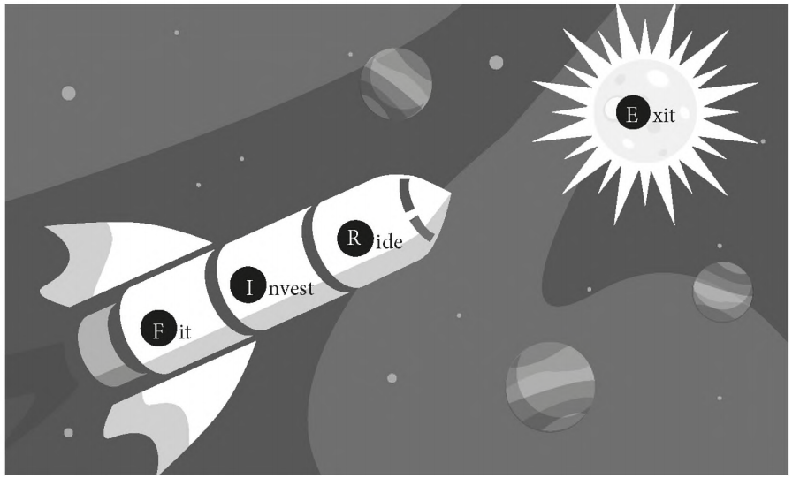
The FIRE framework
Fit,It describes the process by which entrepreneurs and investors find each other and ascertain their mutual interest in making an investment (Match-Making).
Invest,This step captures the process by which an investor and entrepreneur structure their investment.
Ride, which reflects how the entrepreneur and investor interact after the initial investment is made
Exit,This is the “liquidity" event where the investors finally obtain a return on their investment by selling their shares.
Notes:
Figure 1-4 – Stages of New Venture Development
The figure shows the standard progression of development of a new venture from opportunity identification though stages culminating in exit. At each stage, the figure indicates the kinds of actions that normally are associated with the stage, as well as some of the real options the entrepreneur is likely to face.

Slide 27
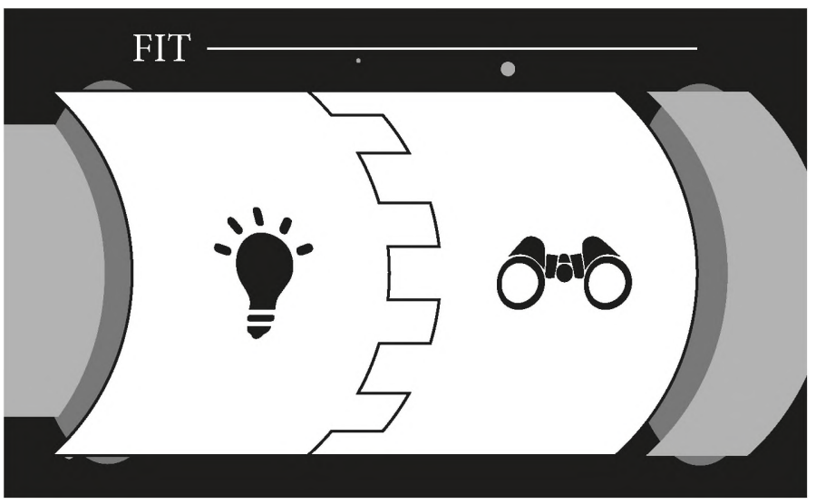
The FIRE framework- Fit
challenges in finding each other and communicating their respective needs and interest (Match, industry, type,).
Investors, on their side, choose what kind of deals they want to look at.
Murnieks, Cardon, Sudek, White, and Brooks, finds that angels are mainly looking for entrepreneurial passion and tenacity.
Parhankangas and Ehrlich, looks at the language used by entrepreneurs. Positive language and self-confidence help to make a good impression.
Bernstein, Korteweg, and Laws() made an experiment on equity crowdfunding platform, information about the founders: who they are and what their prior experiences were.
fineline between Self-confidence and Arrogant
Notes:
The entrepreneur pitching an idea (the light bulb) and the investor screening opportunities (the binoculars), all in the hope of finding a match (the puzzle pieces).
the entrepreneur and investor face challenges in finding each other
and communicating their respective needs and interest. The entrepreneur needs to
identify what types of investors might be interested and to leverage her network
in order to gain access to the relevant ones. She needs to get their attention and
pitch her idea effectively in order to signal the quality of their project. Investors, on
their side, choose what kind of deals they want to look at. They then scout for good
opportunities and go through a screening process to identify which opportunities
they actually want to invest in. The matching process between entrepreneurs and
investors involves both parties gradually getting to know each other and working
their way toward making a deal.

Slide 28
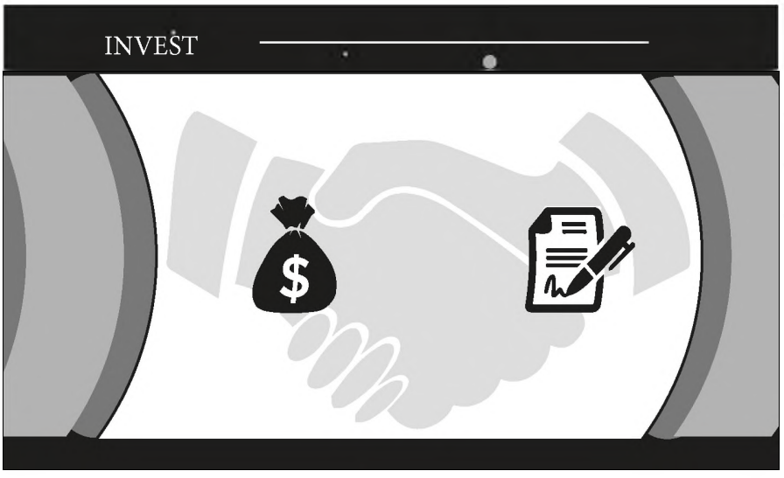
The FIRE framework- Invest
The key challenge
is to find an agreement that satisfies both the entrepreneur and the investor. Such contractual agreement contains two essential elements. First, there is the amount;Second, there is the security.
The amount of funding is determined by both the needs of the company（融资vs投资） and the funding available to the investor(募资vs投资vs管理vs退出，RIME？）.
Securities： Equity is the most common, but there are also debt and nondilutive funding (i.e., funding that does not affect ownership, such as grants).--小米的可转换优先股案例
Term Sheet（T.S）：An investment deal prescribes the details of exactly who gets paid what and when (called “cash flow rights”), as well as who makes what decision and when (called “control rights”)
Notes:
What determines the structure of the investment deal? The entrepreneur’s financial needs emanate from the business model, but the structure of the deal is also colored by the personal preferences of the founders’ team. In addition, investors also have certain
preferences that emanate from the structure of their own organization, something
we examine in the FUEL framework of Section 1.6. The structure of the deal is also
heavily dependent on the market conditions under which these two parties meet,
such as the broader business conditions, and on what the specific circumstances of
the two parties look like. Another important set of determinants are beliefs about
the future of the venture. Throughout the book we emphasize that investments are
driven by expectations about future returns.
经济周期：2018年后中国的宏观经济、货币政策对VC、PE的影响

Slide 29

The FIRE framework- Ride
Along the
ride the entrepreneur and investor learn about the market and the scale of their
business opportunity. In addition, they learn about each other, how to communicate effectively, and how to build trust. This results in decisions about business strategy, management structure, financial structure, and other activities.
This results in decisions about business strategy, management structure, financial structure, and other activities.
It requires a governance structure, especially when there are difficult choices where the entrepreneur and investor disagree with each other. The board of directors is where the company’s important strategic decisions are made, and investors often play a central role on the board.
Co-pilot vs Controller? Stage financing
Notes:
The development of a start-up proceeds in stages. From the perspective of the
company, these stages correspond to important business milestones. While the
details are different for each company, typical stages may include company forma_x0002_tion, development of a first prototype or proof of concept, product development with customer testing, market entry, and market expansion. Business milestones are
achieved at the end of each stage and linked to financing events. Investors want to
give the company enough money to go from one milestone to another and reserve
the right not to provide further funding in case the project falters. As a consequence, financing typically comes in stages
The staging logic underlying Figure 1.8 is closely related to the insights from
Box 1.1. The entrepreneurial process is fundamentally uncertain and involves a series
of experiments. The investment process can therefore be thought of as a series of
risky bets. The bet (a financing round) allows the company to go forward and hit an
important milestone. At this point it needs another bet (another financing round)
to proceed. The hope is that with enough bets the venture eventually finds a lucra_x0002_tive exit.36

Slide 30

The FIRE framework- Exit
shows two types of exits: successful ones (represented by a sun) and unsuccessful ones (represented by a black hole).
two types of successful exit. the IPO and acquization at a high valuation,
Unsuccessful exits take several forms. They may consist of ceasing operations, liquidating assets, declaring bankruptcy, or getting acquired at a low valuation.
Another type of exit is a partial or full sale of company shares to a financial buyer. This exit is often associated with intermediate company performance.
Finally, some companies never seem to find their way to an exit, being stuck in a limbo of neither making any progress nor being ready to close down. They are sometimes referred to as the “living dead” or “zombies.”
Notes:
The development of a start-up proceeds in stages. From the perspective of the
company, these stages correspond to important business milestones. While the
details are different for each company, typical stages may include company forma_x0002_tion, development of a first prototype or proof of concept, product development with customer testing, market entry, and market expansion. Business milestones are
achieved at the end of each stage and linked to financing events. Investors want to
give the company enough money to go from one milestone to another and reserve
the right not to provide further funding in case the project falters. As a consequence, financing typically comes in stages
The staging logic underlying Figure 1.8 is closely related to the insights from
Box 1.1. The entrepreneurial process is fundamentally uncertain and involves a series
of experiments. The investment process can therefore be thought of as a series of
risky bets. The bet (a financing round) allows the company to go forward and hit an
important milestone. At this point it needs another bet (another financing round)
to proceed. The hope is that with enough bets the venture eventually finds a lucra_x0002_tive exit.36

Slide 31
3.创业企业融资FUEL模型
Notes:
监管者视角：preparing for the assessment of the viability and sustainability of their business models by regulators and investors in light of the on-going challenging environment;
and
管理层视角：
analysing their business models to ensure they are maximising shareholder value.

Slide 32

Main Types of Investors:The FUEL Framework
Add Fuel to Fire
Notes:
A common misconception among entrepreneurs is that all investors are the same; that
is that “money is green.” This view is far from true, however, and throughout this book
we emphasize the diversity of investor types and its importance for the fundraising
process.
The FUEL framework is based on four core concepts that help to structure our
understanding of the identity and behaviors of the investors. Each concept is associ_x0002_ated with one central question that sets up the core issue and two further questions
that elaborate on that core.
1. Fundamental structure
• What is the investor’s fundamental identity?
• What is the investor’s organizational structure and financial resources?
• What is the investor’s governance structure and decision-making process?
2. Underlying motivation
• What does the investor want?
• How important are financial and nonfinancial returns to the investors?
• How risk tolerant and patient is the investor?
3. Expertise and networks
• What does the investor offer to the entrepreneur?
• What expertise does the investor bring to the table?
• What networks can the investor draw on?
4. Logic and style
• How does the investor operate?
• What logical criteria does the investor use to select companies?
• What is the investor’s style of interacting with the companies?

Slide 33
The FUEL Framework-Fundemental Structure
• What is the investor’s fundamental identity?
• What is the investor’s organizational structure and financial resources?
• What is the investor’s governance structure and decision-making process?
关注点：投资人是谁？他们如何决策？拥有什么资源？
Notes:
A common misconception among entrepreneurs is that all investors are the same; that
is that “money is green.” This view is far from true, however, and throughout this book
we emphasize the diversity of investor types and its importance for the fundraising
process.
The FUEL framework is based on four core concepts that help to structure our
understanding of the identity and behaviors of the investors. Each concept is associated with one central question that sets up the core issue and two further questions that elaborate on that core.
1. Fundamental structure
• What is the investor’s fundamental identity?
• What is the investor’s organizational structure and financial resources?
谁拥有投资主体？可供投资的资金和资源。
• What is the investor’s governance structure and decision-making process?
治理机制和决策机制。

Slide 34
Sources of Financing and Valuation
“It is far more important whose money you get than how much you get or how much you pay for it.”-Bygrave and Timmons (1992)？
investor types underlie many of the key features of how the investor interacts with entrepreneurs and other parties.
天使vsVC：angels invest their own money, whereas VCs invest other people’s money.
IVC、CVC、GVC
Notes:
Bygrave, W. D., and J. A. Timmons. 1992. Venture Capital at the Crossroads. Boston: Harvard Business School
Press.
VC声誉-Both academics and practitioners have argued that high-reputation VCs are better at providing the above services than low-reputation VCs
VC experience-industry, portfolio, IPO exit
VC类型-IVC、CVC、GVC
The short version is that angels invest their own money, whereas VCs invest
other people’s money. For the long version, note that the structure of angel investors
is fairly simple. Angels invest their own money and are accountable to no one else
(spouses apart). Compare this to the VC structure, shown in Figure 1.12. An en_x0002_trepreneurial company receives funding from a VC fund, which is a legal vehicle
administered by a limited liability company (the general partner) and run by a group
of individuals (the VCs). The general partner enters into an agreement with a set
of institutional investors (the limited partners) that provide the funding of the VC
fund. Institutional investors are large investment managers, such as pension funds,
insurance companies, university endowments, sovereign wealth funds, investment
banks (representing themselves or their clients), wealthy families, and others.
Most angels only invest relatively modest
amounts, limited by how much wealth they have and how much they are willing
to risk. By contrast, VCs can have access to much larger sums of money, depending
on the size of the fund (which can range between $50M and over $1B). Second, we
consider who makes the key decisions. Angel investors make their own decisions,
whereas VCs take decisions by investment committees that are governed by partner_x0002_ship rules and may be subject to oversight by the limited partners. Clearly, we would
expect different investments to come out of these different investor structures. In
fact, the same individual may adopt different investment styles when acting as a VC
versus investing privately as an angel investor.

Slide 35
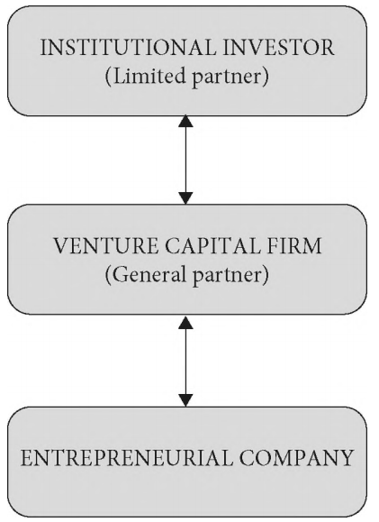
The venture capital structure
The general partner enters into an agreement with a set of institutional investors (the limited partners) that provide the funding of the VC fund.
LP
GP
Notes:
who the relevant people are, how they make decisions, and what resources they control.
Angels invest their own money and are accountable to no one else
(spouses apart). Compare this to the VC structure, shown in Figure 1.12. An en_x0002_trepreneurial company receives funding from a VC fund, which is a legal vehicle
administered by a limited liability company (the general partner) and run by a group
of individuals (the VCs). The general partner enters into an agreement with a set
of institutional investors (the limited partners) that provide the funding of the VC
fund. Institutional investors are large investment managers, such as pension funds,
insurance companies, university endowments, sovereign wealth funds, investment
banks (representing themselves or their clients), wealthy families, and others.

Slide 36
The FUEL Framework-Underlying motivation
• What does the investor want?
• How important are financial and nonfinancial returns to the investors?
• How risk tolerant and patient is the investor?
Notes:
2. Underlying motivation
• What does the investor want? （财务回报vs更广泛目标；国外天使投资者与中国天使投资人差异--战略整合， Lee Hower, who was part of LinkedIn’s founding team and is now an experienced in_x0002_vestor, lists five main motivations: return, market insights, path to a VC career, help to the community, and personal enjoyment）
• How important are financial and nonfinancial returns to the investors?
• How risk tolerant and patient is the investor?

Slide 37
The FUEL Framework-Expertise and networks
• What does the investor offer to the entrepreneur?
（Money and ？）
• What expertise does the investor bring to the table?（Experties:投资方拥有的专长和技能；-Value Added， Screening）
• What networks can the investor draw on?
（Networks:投资方可以调动的资源）；
Angel vs VC
Notes:
3. Expertise and networks
• What does the investor offer to the entrepreneur?
• What expertise does the investor bring to the table?
• What networks can the investor draw on?
Expertise is needed to prop_x0002_erly screen out the right companies and add value along the ride. Networks are needed
to help the entrepreneur gain access to key resources as the venture develops. Put dif_x0002_ferently, expertise concerns the knowledge and skills that the investors have by them_x0002_selves, and networks concern the knowledge and skills that they can gain access to.
4. Logic and style
• How does the investor operate?
• What logical criteria does the investor use to select companies?
• What is the investor’s style of interacting with the companies?

Slide 38
The FUEL Framework-Logic and style
• How does the investor operate?
• What logical criteria does the investor use to select companies?
• What is the investor’s style of interacting with the companies? (Hands-on vs Hands-off)
Notes:
4. Logic and style
• How does the investor operate?
• What logical criteria does the investor use to select companies?
• What is the investor’s style of interacting with the companies?
The “logic” component links to the first (Fit) and second (Invest) steps of the
FIRE framework. It looks at what types of deals make sense and how to structure them.
The “style” component then considers how the investor and entrepreneur interact
throughout the rest of entrepreneurial financing process, that is, the Ride and Exit steps.

Slide 39
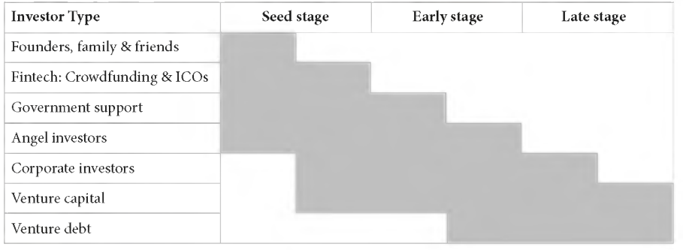
Stage specialization of main investor types
The short version is that angels invest their own money, whereas VCs invest other people’s money.
Notes:
A common misconception among entrepreneurs is that all investors are the same; that
is that “money is green.” This view is far from true, however, and throughout this book
we emphasize the diversity of investor types and its importance for the fundraising
process.
Why does the fundamental structure matter? First, we consider whose money
is being invested and how much of it. Most angels only invest relatively modest
amounts, limited by how much wealth they have and how much they are willing
to risk. By contrast, VCs can have access to much larger sums of money, depending
on the size of the fund (which can range between $50M and over $1B). Second, we
consider who makes the key decisions. Angel investors make their own decisions,
whereas VCs take decisions by investment committees that are governed by partner_x0002_ship rules and may be subject to oversight by the limited partners. Clearly, we would
expect different investments to come out of these different investor structures. In
fact, the same individual may adopt different investment styles when acting as a VC
versus investing privately as an angel investor.
不确定性 (Uncertainty)主要 指不能 判断特定结 果发 生的可能 性 (Weick，1995)，风险是 不确定性 的一种 类型 ，其未来 可能发 生的事件 的概 率被认 为是 已知 的 (Knight，1921)。
Knight，F．H．，192l，Risk，Uncertainty and P， t，HoughtonMiflinCompany．
Weick，K．E．，1995，Sensemaking in Organizations，SagePublications．

Slide 40
Financial Performance and the Stages of New Venture Development
Development
Start-up
Early-growth
Rapid-growth
Exit
Notes:
Finance sources such as boot-strap finance, bricolage, and crowd-funding are frequently used to start businesses.

Slide 41
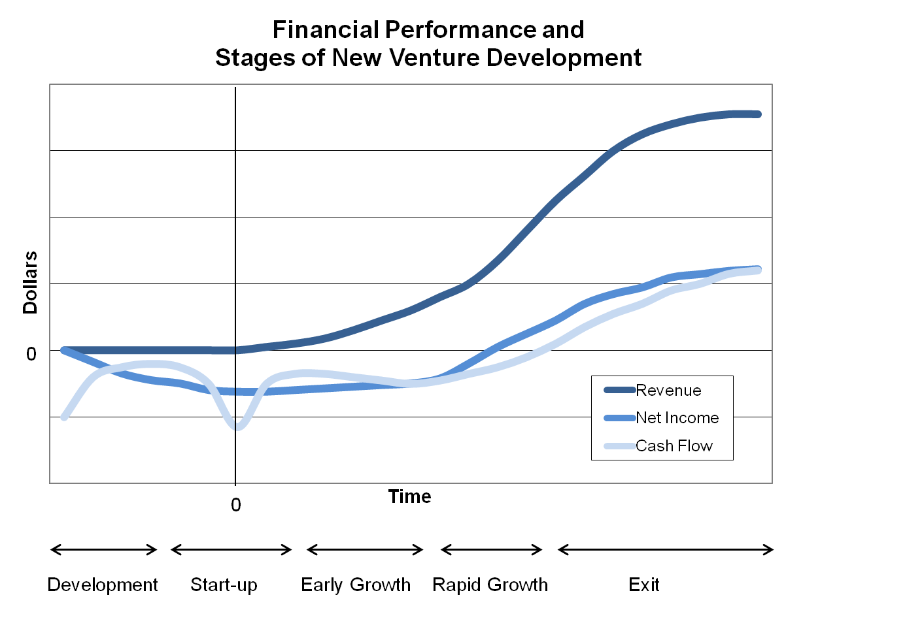
Figure 1.5
Notes:
Figure 1-5 – Stages of New Venture Development
The figure reflects five stages that are typical of new venture development. During the development stage, the venture generates no revenues, net income is negative, and cash flow is negative. Start-up begins when the firm acquires the facilities, equipment, and employees required to produce the product. During early growth, revenue is growing, but both net income and cash flow available to investors are negative. Rapid growth is the last stage during which external financing is required. During exit, the rate of growth declines to the point where cash flow available to investors is positive.

Slide 42
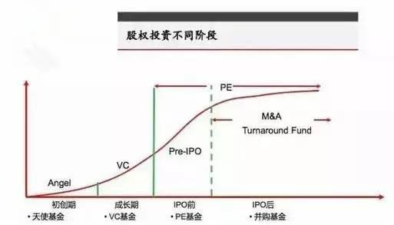

Slide 43
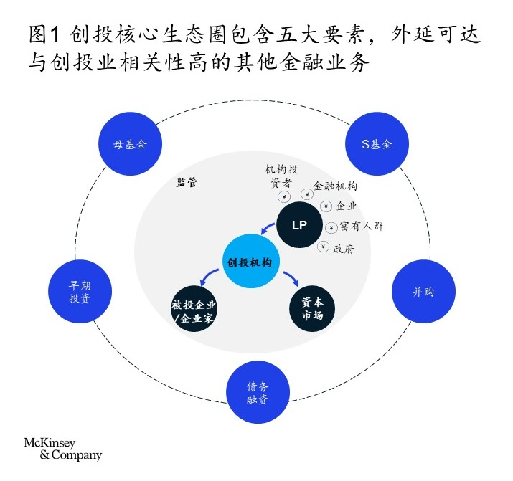
Notes:
https://www.mckinsey.com.cn/%E9%80%8F%E8%A7%86%E4%B8%AD%E5%9B%BD%E5%88%9B%E6%8A%95%E7%94%9F%E6%80%81%EF%BC%8C%E6%8A%93%E4%BD%8F%E5%8D%81%E5%B9%B4%E9%BB%84%E9%87%91%E6%9C%9F/

Slide 44
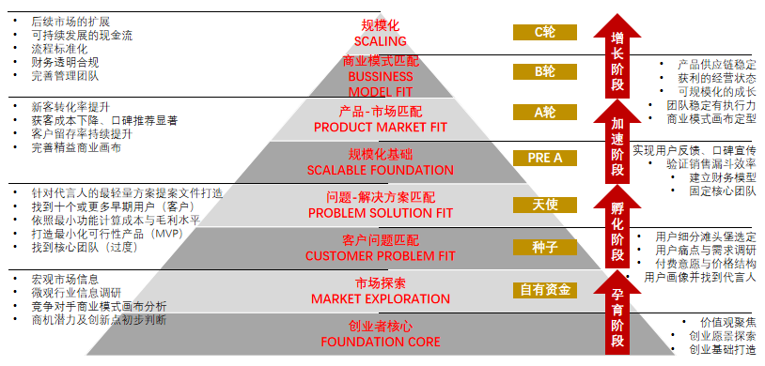
里程碑与融资方式

Slide 45
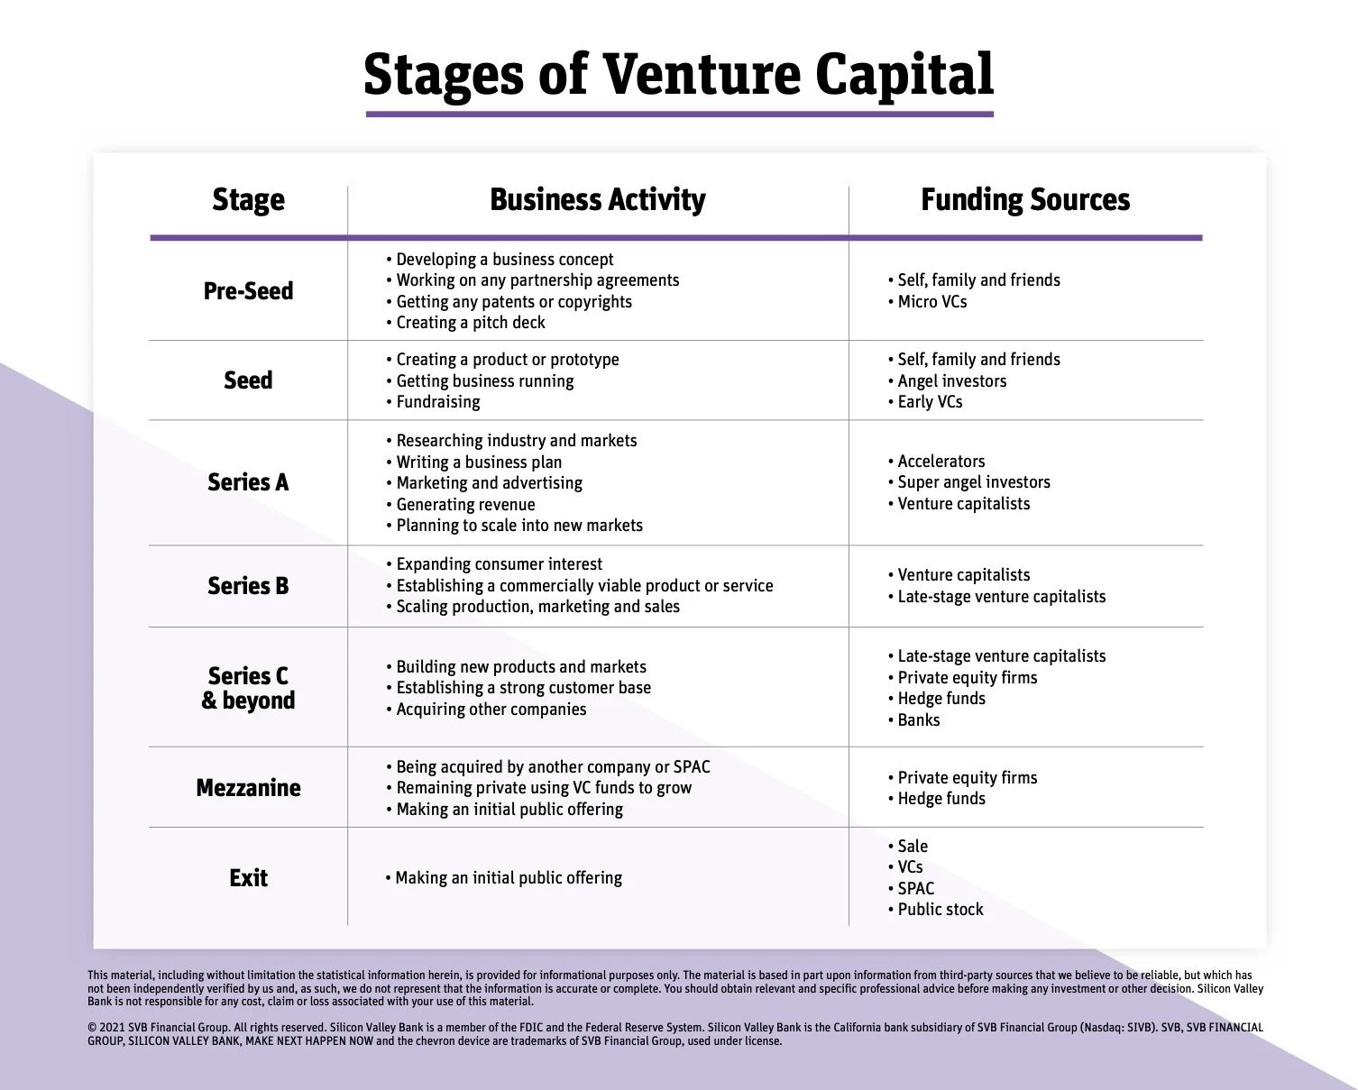
https://www.svb.com/startup-insights/vc-relations/stages-of-venture-capital/
https://www.svb.com/startup-insights/venture-debt/what-is-venture-debt/

Slide 46
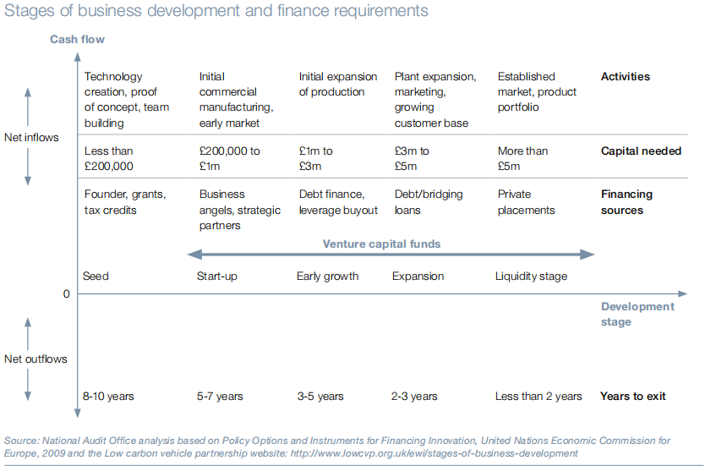
Notes:
The Department has experimented with a variety of fund models commonly
used in the venture capital industry. The Regional Venture Capital Funds, Enterprise
Capital Funds and the Bridges Funds are based on a model of direct investment by
the fund in the underlying businesses. Early Growth Funds, an element of the new
Capital for Enterprise Fund and the Aspire Fund, are based on a co-investment model.
The co-investment model relies on investors finding potential businesses in which to
invest and presenting these to the fund manager. The fund manager takes a decision
on whether to invest alongside the private investor based on an evaluation of the latter’s
investment track record and the strength of their due diligence work, rather than on a
direct evaluation of the underlying business. The UK High Technology Fund and the
other element of the Capital for Enterprise Fund are based on a fund-of-funds model
which allows the Government to invest in a number of underlying venture capital funds
thereby increasing the diversification of investments.

Slide 47
Summary
There are many types of entrepreneurial activity
The Finance Paradigm and maximization of value for the entrepreneur will guide decision making
Milestones can create value and may benefit the entrepreneur and investors
A venture’s financing needs and options are linked to its stage of growth
Business plans are both important and different for new ventures

